Slide 1

WELCOME
!
WELCOME
!
WELCOME
!
WELCOME
!
WELCOME
!
WELCOME
!
WELCOME
!

Slide 2
WELCOME
!
WELCOME
!
WELCOME
!
WELCOME
!
WELCOME
!
WELCOME
!
WELCOME
!

Slide 3


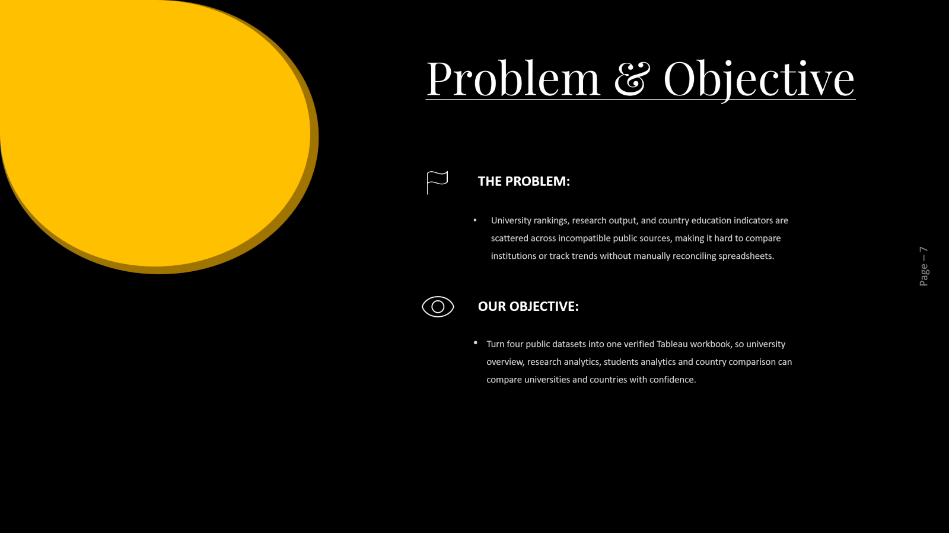
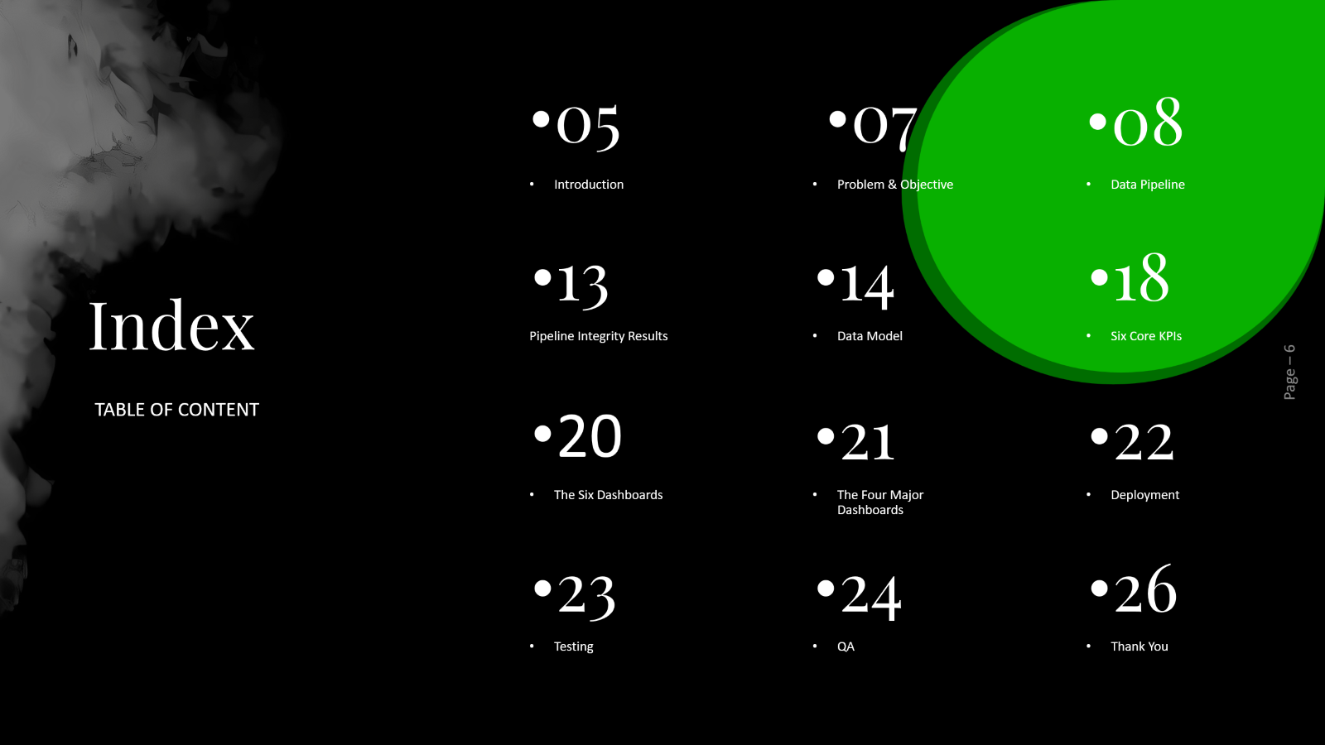

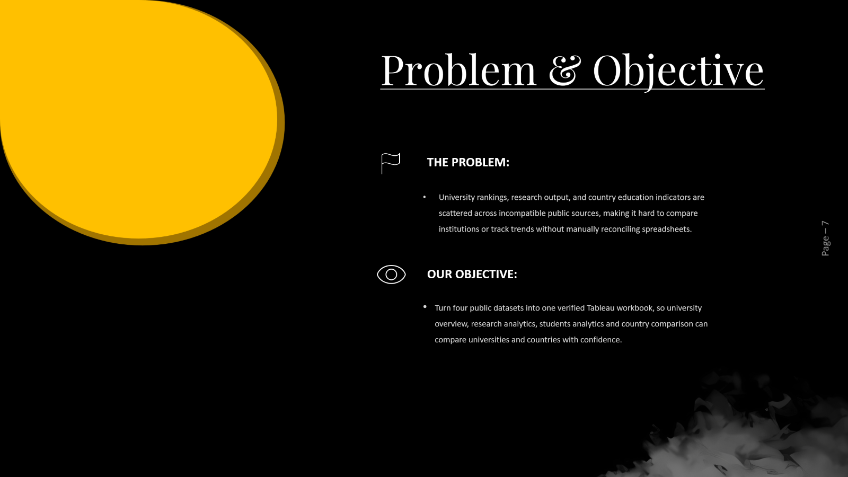

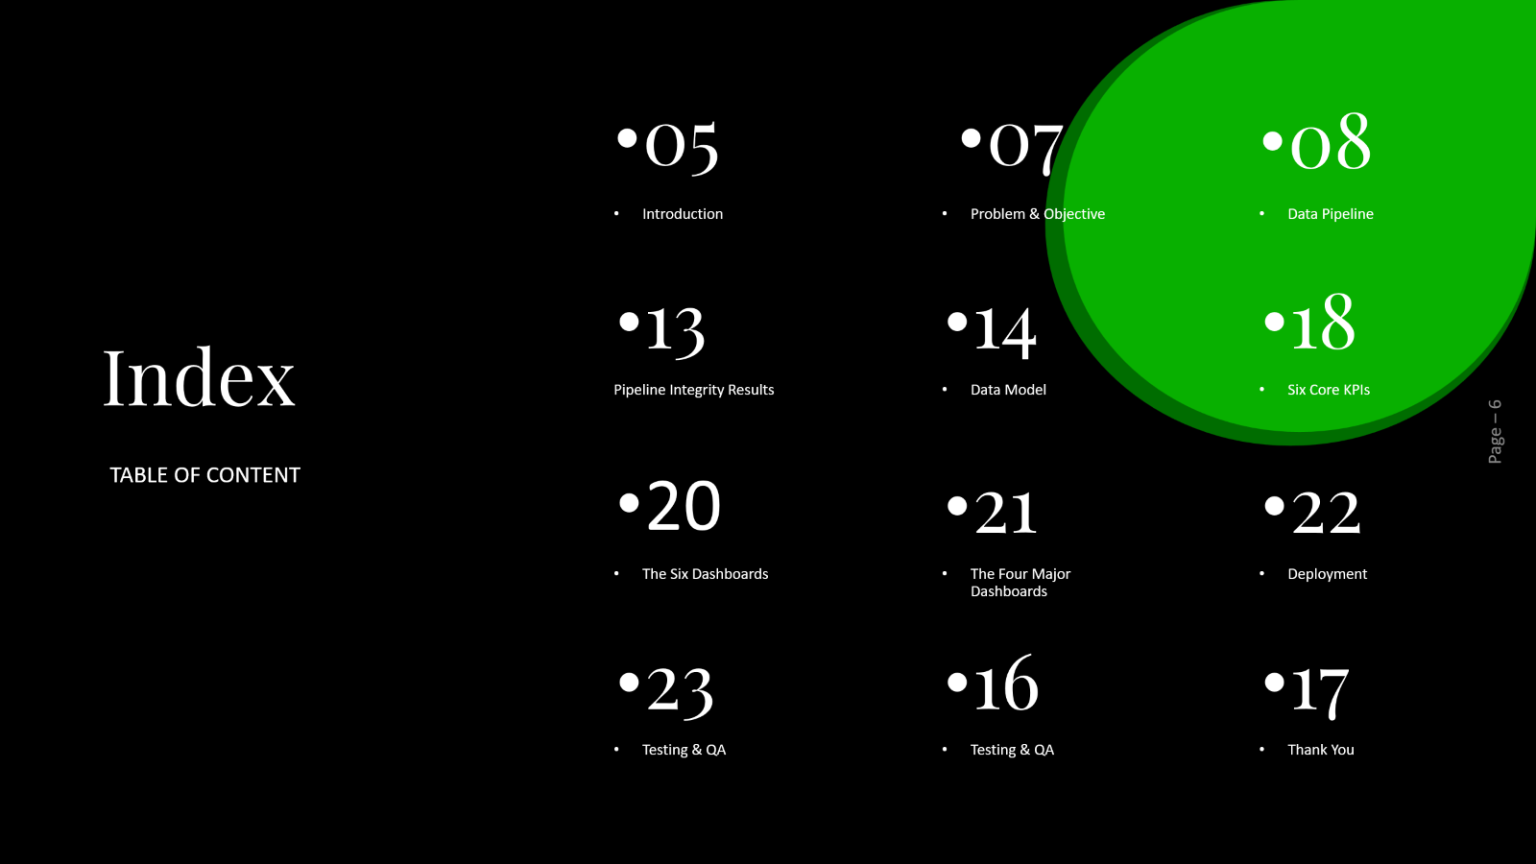

Slide 4

EduVision DV
HIGHER EDUCATION PERFORMANCE DASHBOARD
Higher-Education-Intelligence-System.../
|-- README.md
|-- LICENSE
|-- .gitignore
|
|-- Dim_&_Fact_Datasets/ Final dimension and fact tables (Tableau data source)
| |-- 01_University_Overview/ dim_country.xlsx, dim_university.xlsx, fact_university_overview.xlsx
| |-- 02_Research_Analytics/ dim_university.xlsx, fact_research_analytics.xlsx
| |-- 03_Student_Analytics/ dim_university.xlsx, fact_student_analytics.xlsx
| |-- 04_Country_Comparison/ dim_country.xlsx, dim_indicator.xlsx, fact_country_indicators.xlsx
| |-- split_qa_log.txt QA log from splitting the master pipeline output into dim/fact tables
|
|-- Milestone 01/ Data Collection and Preparation
| |-- Script/ data_collection.py, Executed Script/ (Colab notebook run as PDF)
| |-- Raw Datasets/ 01 to 04, one folder per dataset, source files as downloaded
| |-- Deliverables/
| |-- Module 1/ data_collection.py, university_raw_data.csv/ (6 source files)
| |-- Module 2/ script/education_cleaning.ipynb, university_cleaned.csv/ (4 cleaned files)
|
|-- Milestone 02/ KPI Engineering and Dashboard Planning
| |-- KPIs Dataset/ Six KPIs.xlsx
| |-- Deliverables/
| |-- Module 3/ university_final_dataset.py, university_final_dataset.xlsx
| |-- Module 4/ dashboard_storyboard.pdf, eduvision_prototype.mp4, eduvision_prototype.twbx
|
|-- Milestone 03/ Dashboard Development
| |-- Deliverables/
| |-- Module 5/ Tableau Dashboard Development.pdf, QS and THE Visualisation.pdf, eduvision_dashboard_v1.twbx
| |-- Module 6/ EduVision DV.twbx, Sample.png
|
|-- Milestone 04/ Testing and Delivery
|-- Deliverables/
|-- Module 7/ Dashboard Testing Report.pdf, QA Checklist.pdf
|-- Module 8/ EduVision DV.twbx, Final Documentation.pdf, GitHub Repository.md, Tableau Public.md

Slide 5
INTRODUCTION
EduVision DV
A Unified Tableau Workbook for Higher Education Analytics
EduVision DV Project Presentation

Slide 6
05
07
08
Introduction
Problem & Objective
Data Pipeline
13
14
18
Index
Pipeline Integrity Results
Data Model
Six Core KPIs
TABLE OF CONTENT
20
21
22
The Six Dashboards
The Four Major Dashboards
Deployment
23
24
26
Testing
QA
Thank You

Slide 7
Problem & Objective
THE PROBLEM:
University rankings, research output, and country education indicators are scattered across incompatible public sources, making it hard to compare institutions or track trends without manually reconciling spreadsheets.
OUR OBJECTIVE:
Turn four public datasets into one verified Tableau workbook, so university overview, research analytics, students analytics and country comparison can compare universities and countries with confidence.

Slide 8

COUNTRY COMPARISON
Data Model
World Bank EdStats, 33,450 rows, country level indicators by year.
University Overview:
Top Global Ranking, Total Universities, Average Overall Score, Total International Students Percentage, Avg. Faculty Student Ratio
Top University Rankings in 2024, Top University Rankings in 2025
Global University Distribution, Academic Reputation Analysis
University Performance Trends, Institutional Comparison
STUDENT DATA
RESEARCH ANALYTICS
WUR 2023, 812 universities, enrollment and diversity indicators.
THE 2024 plus WUR 2023 fallback, 918 universities with a verified research metric.

Slide 9
OUR
Data Sources
QS & THE WORLD RANKINGS
QS World University Rankings 2025 (1,503 institutions) and THE World University Rankings 2024 (867 institutions) provide the master ranking and primary research metrics.

Slide 10
OUR
Data Sources
QS & THE WORLD RANKINGS
WORLD UNIVERSITY RANKINGS 2023
QS World University Rankings 2025 (1,503 institutions) and THE World University Rankings 2024 (867 institutions) provide the master ranking and primary research metrics.
World University Rankings 2023 (812 institutions), used as the fallback research metric source and for student body and diversity indicators.

Slide 11
OUR
Data Sources
QS & THE WORLD RANKINGS
WORLD UNIVERSITY RANKINGS 2023
WORLD BANK EDSTATS
QS World University Rankings 2025 (1,503 institutions) and THE World University Rankings 2024 (867 institutions) provide the master ranking and primary research metrics.
World University Rankings 2023 (812 institutions), used as the fallback research metric source and for student body and diversity indicators.
World Bank Education Statistics: 55,918 rows of country level indicators, synced down to 33,450 rows matching the master university countries.

Slide 12
FIVE STEPS, ZERO FABRICATED VALUES
Data Pipeline
STEP 3
STEP 2
STEP 1
STEP 0
STEP 4-5
Raw shapes profiled: 1,503 (QS) + 867 (THE) + 812 (WUR) + 55,918(EdState) rows
Fix master region label, dedupe, validate
Sync all datasets to the master universe
Cascade THE 2024 research data, fallback to WUR 2023
Build Six KPIs and Final Dataset, 918 rows each

Slide 13
FIVE STEPS, ZERO FABRICATED VALUES
Data Pipeline
STEP 4-5
STEP 3
STEP 2
STEP 0
STEP 1
Sync all datasets to the master universe
Cascade THE 2024 research data, fallback to WUR 2023
Build Six KPIs and Final Dataset, 918 rows each
Raw shapes profiled: 1,503 (QS) + 867 (THE) + 812 (WUR) + 55,918(EdState) rows
Fix datasets region label, duplicates, validate

Slide 14
FIVE STEPS, ZERO FABRICATED VALUES
Data Pipeline
STEP 4-5
STEP 3
STEP 0
STEP 1
STEP 2
Cascade THE 2024 research data, fallback to WUR 2023
Build Six KPIs and Final Dataset, 918 rows each
Raw shapes profiled: 1,503 (QS) + 867 (THE) + 812 (WUR) + 55,918(EdState) rows
Fix datasets region label, duplicates, validate
Sync all datasets, using
university_id, country_id

Slide 15
FIVE STEPS, ZERO FABRICATED VALUES
Data Pipeline
STEP 4-5
STEP 0
STEP 1
STEP 2
STEP 3
Build Six KPIs and Final Dataset, 918 rows each
Raw shapes profiled: 1,503 (QS) + 867 (THE) + 812 (WUR) + 55,918(EdState) rows
Fix datasets region label, duplicates, validate
Sync all datasets, using
university_id, country_id
Finalize into DIM and Measures,
Dim and Fact Tables

Slide 16
PIPELINE INTEGRITY RESULTS
SIX KPIs UNIVERSE
MASTER UNIVERSITIES
FIVE STEPS, ZERO FABRICATED VALUES
918
Data Pipeline
1,503
STEP 0
STEP 1
STEP 2
STEP 3
STEP 4-5
FABRICATED VALUES USED
COUNTRY ROWS SYNCED
Raw shapes profiled: 1,503 (QS) + 867 (THE) + 812 (WUR) + 55,918(EdState) rows
Fix datasets region label, duplicates, validate
Sync all datasets, using
university_id, country_id
Finalize into DIM and Measures,
Dim and Fact Tables
Build Six KPIs and Final Dataset, 918 rows each
0
33,450

Slide 17
PIPELINE INTEGRITY RESULTS
UNIVERSITY
OVERVIEW
SIX KPIs
918
1,503
COUNTRY ROWS SYNCED
FABRICATED
VALUES USED
33,450
0

Slide 18

MASTER (Hub)
QS 2025, 1,503 universities, the single source of truth every other table keys off.
Data Model
Research Analytics:
Publications Analysis, Citation Performance, Research Productivity Trends
Top Research Institutions, Research Impact Comparison
Avg. Research Score, Avg. Citations Score, Avg. Industry Income, Avg. Teaching Score, Avg. International Outlook, Avg. International Outlook
COUNTRY COMPARISON
World Bank EdStats, 33,450 rows, country level indicators by year.
RESEARCH ANALYTICS
THE 2024 plus WUR 2023 fallback, 918 universities with a verified research metric.

Slide 19

STUDENT DATA
WUR 2023, 812 universities, enrollment and diversity indicators.
Data Model
MASTER (Hub)
QS 2025, 1,503 universities, the single source of truth every other table keys off.
Student Analytics:
International Student Analysis, Faculty-To-Student Ratio Analysis
Student Diversity Trends, Enrollments Comparisons, Student Distribution Analysis
Avg. Female Percentage, Avg. Male Percentage, Avg. Employment Outcome, Total Students, Total Global Students
COUNTRY COMPARISON
World Bank EdStats, 33,450 rows, country level indicators by year.

Slide 20

STUDENT DATA
WUR 2023, 812 universities, enrollment and diversity indicators.
Data Model
RESEARCH ANALYTICS
THE 2024 plus WUR 2023 fallback, 918 universities with a verified research metric.
Country Comparison:
Country Ranking Comparison, Education Performance Benchmarking, Regional Education Trends
• Top Performing Countries, Total Countries Covered
• Selected Indicator Average, Maximum Indicator Value, Minimum Indicator Value
• High Income by OECD, High Income by nonOECD, Data Coverage Timeline
MASTER (Hub)
QS 2025, 1,503 universities, the single source of truth every other table keys off.

Slide 21

SIX CORE KPIs
Global Ranking Score
Research Impact Score
Faculty-to-Student Ratio
The institution's overall position in the combined ranking, built from the QS 2025 and THE ranking positions. Displayed as both a numeric rank and an overall score out of 100.
Derived from: rank_2024_numeric, rank_2025_numeric, overall_score.
A composite measure of an institution's research output and influence, combining research volume, citation strength, and industry income.
Derived from: scores_research, scores_citations, scores_industry_income.
The number of students per faculty member at an institution, expressed as a ratio such as 1 to 17.3. A lower number of students per faculty member generally indicates more individual attention.
Derived from: student_staff_ratio, total_students.

Slide 22

SIX CORE KPIs
International Student Percentage
Academic Reputation Score
Research Productivity Index
A normalized measure of research output volume relative to institution size, allowing fair comparison between large and small institutions.
Derived from: scores_research combined with total_students.
The share of an institution's total enrolled students who are international students.
Derived from: international_students_percentage, total_students.
A survey based measure of how highly an institution is regarded by academic peers, one of the core inputs to the QS ranking methodology.
Derived from: academic_reputation, employer_reputation.

Slide 23
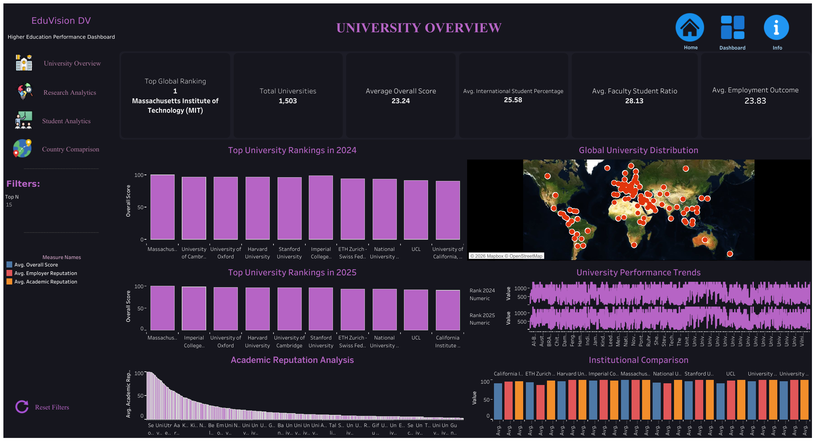
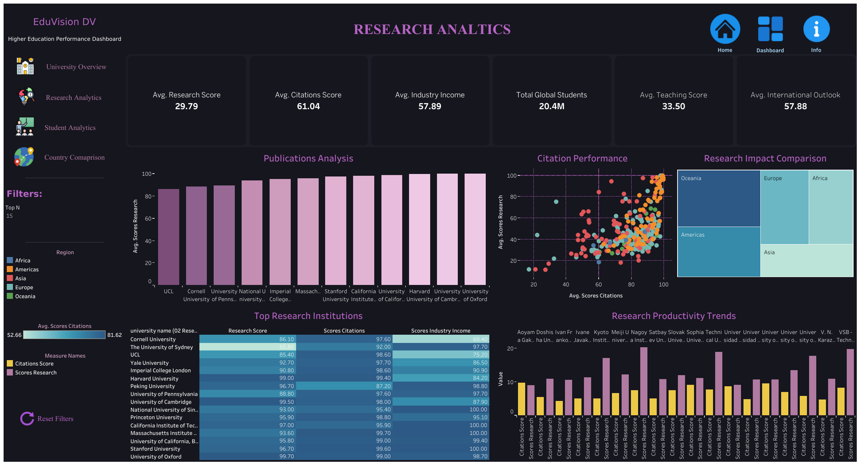
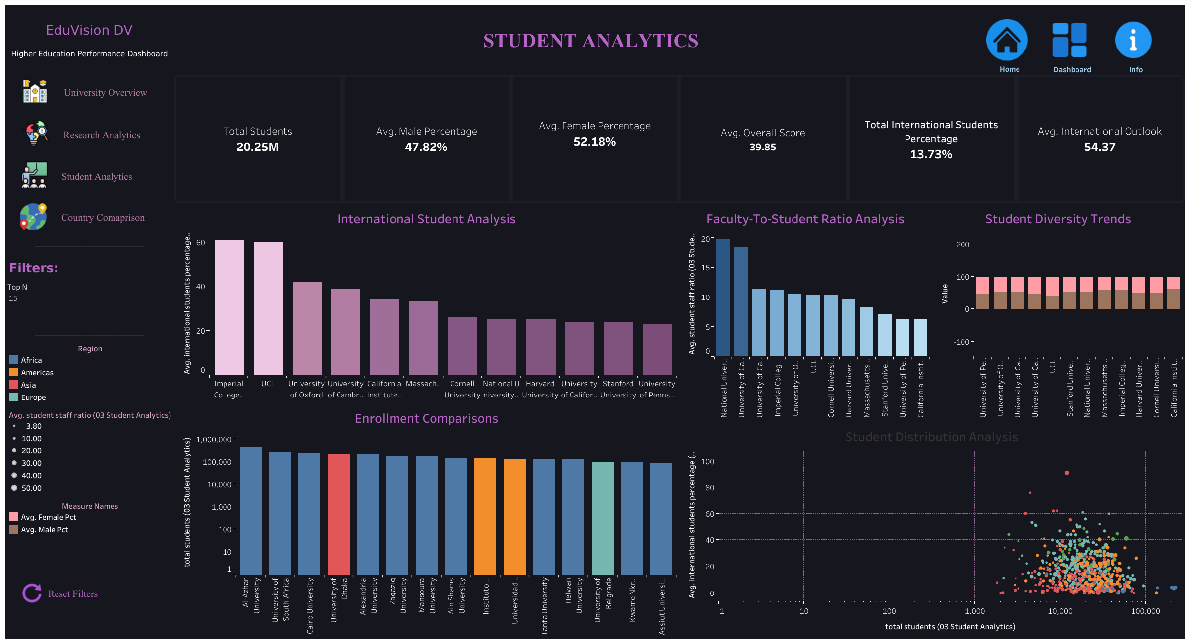
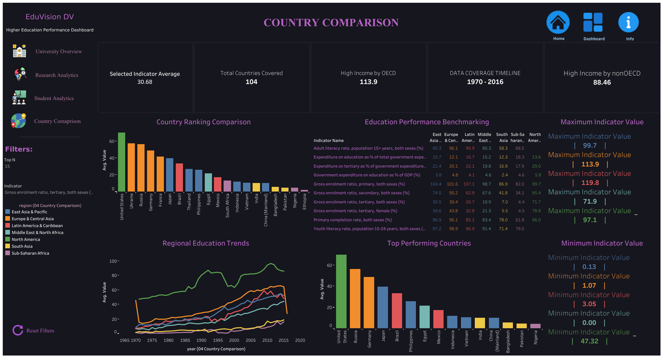
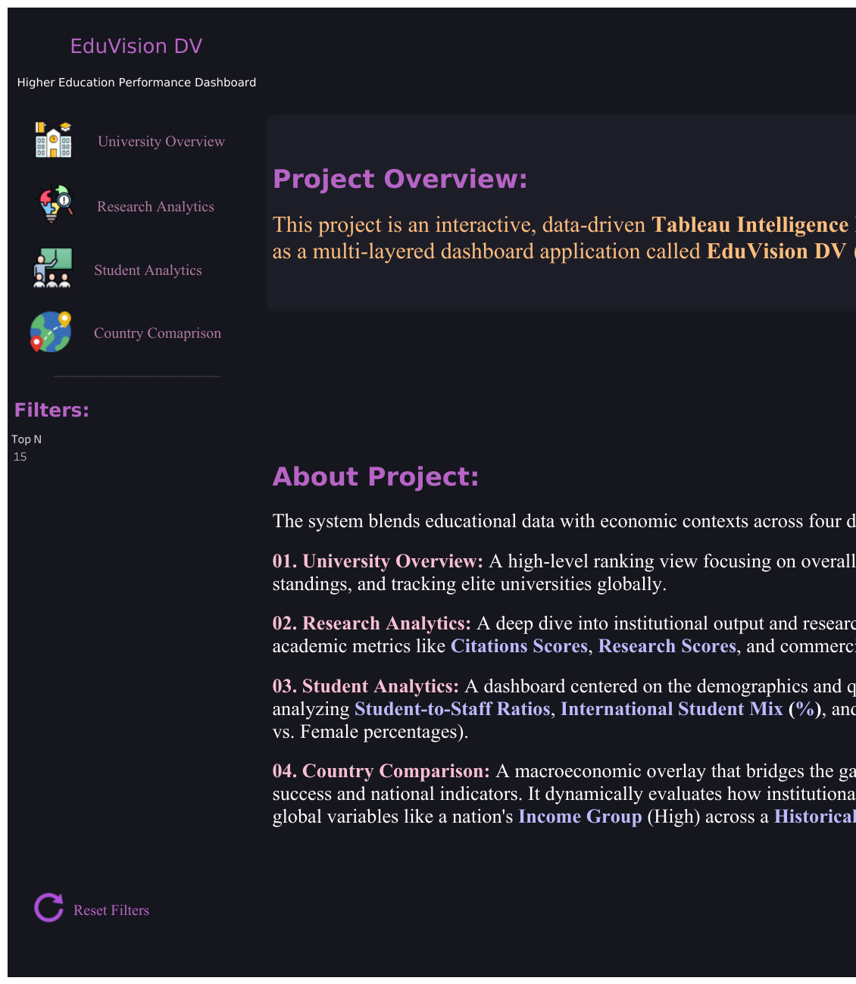
The Six
Dashboards
EDUVISION DV
Home & Navigation
UNIVERSITY OVERVIEW
RESEARCH ANALYTICS
STUDENT ANALYTICS
COUNTRY COMPARISON
INFO DASHBOARD

Slide 24

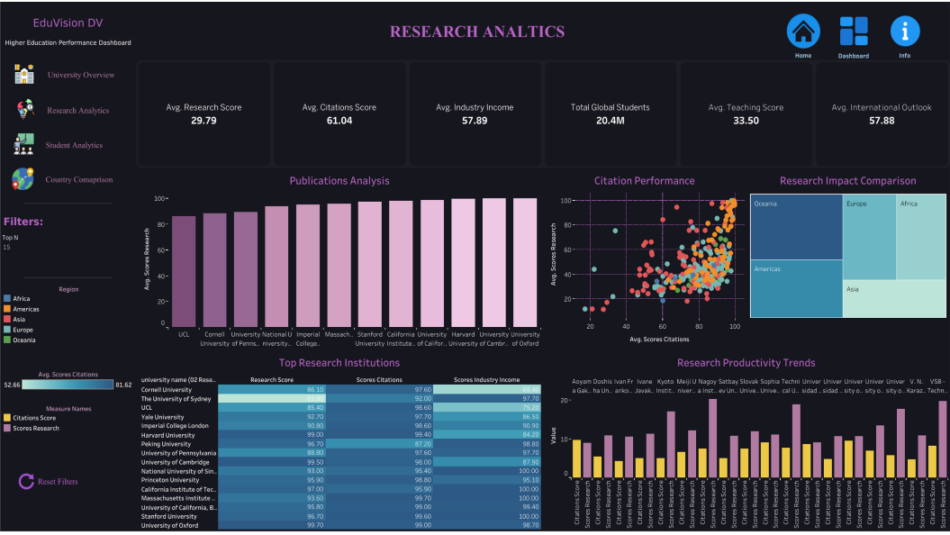
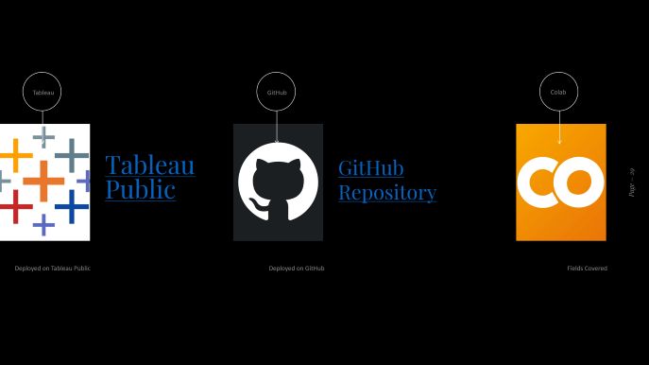

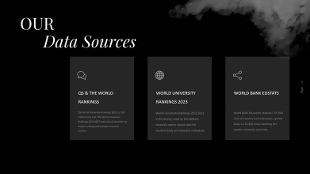
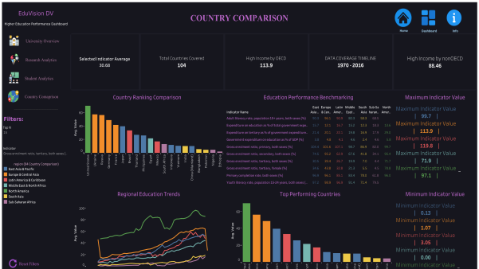




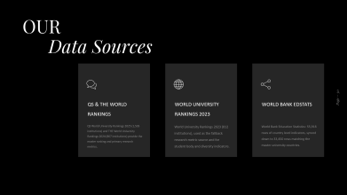

Slide 29



Tableau
GitHub
Colab
Tableau Public
GitHub Repository
Deployed on Tableau Public
Deployed on GitHub
Fields Covered

Slide 30

TESTING & QA RESULTS
20
Test cases executed
20
Test cases passed
1
Defect found & fixed

Slide 31

Thank
You for Watching
EduVision DV Final Presentation

